Slide 1




Towards an App Store for Education
Dr. Charles Severance
University of Michigan School of Information
www.tsugi.org www.koseu.org
https://www.slideshare.net/csev

Slide 2
Outline
The Conditions for an App Store
The Standards for the App Store
Training App Developers
App Software Framework
App Hosting Framework
Next Steps

Slide 3
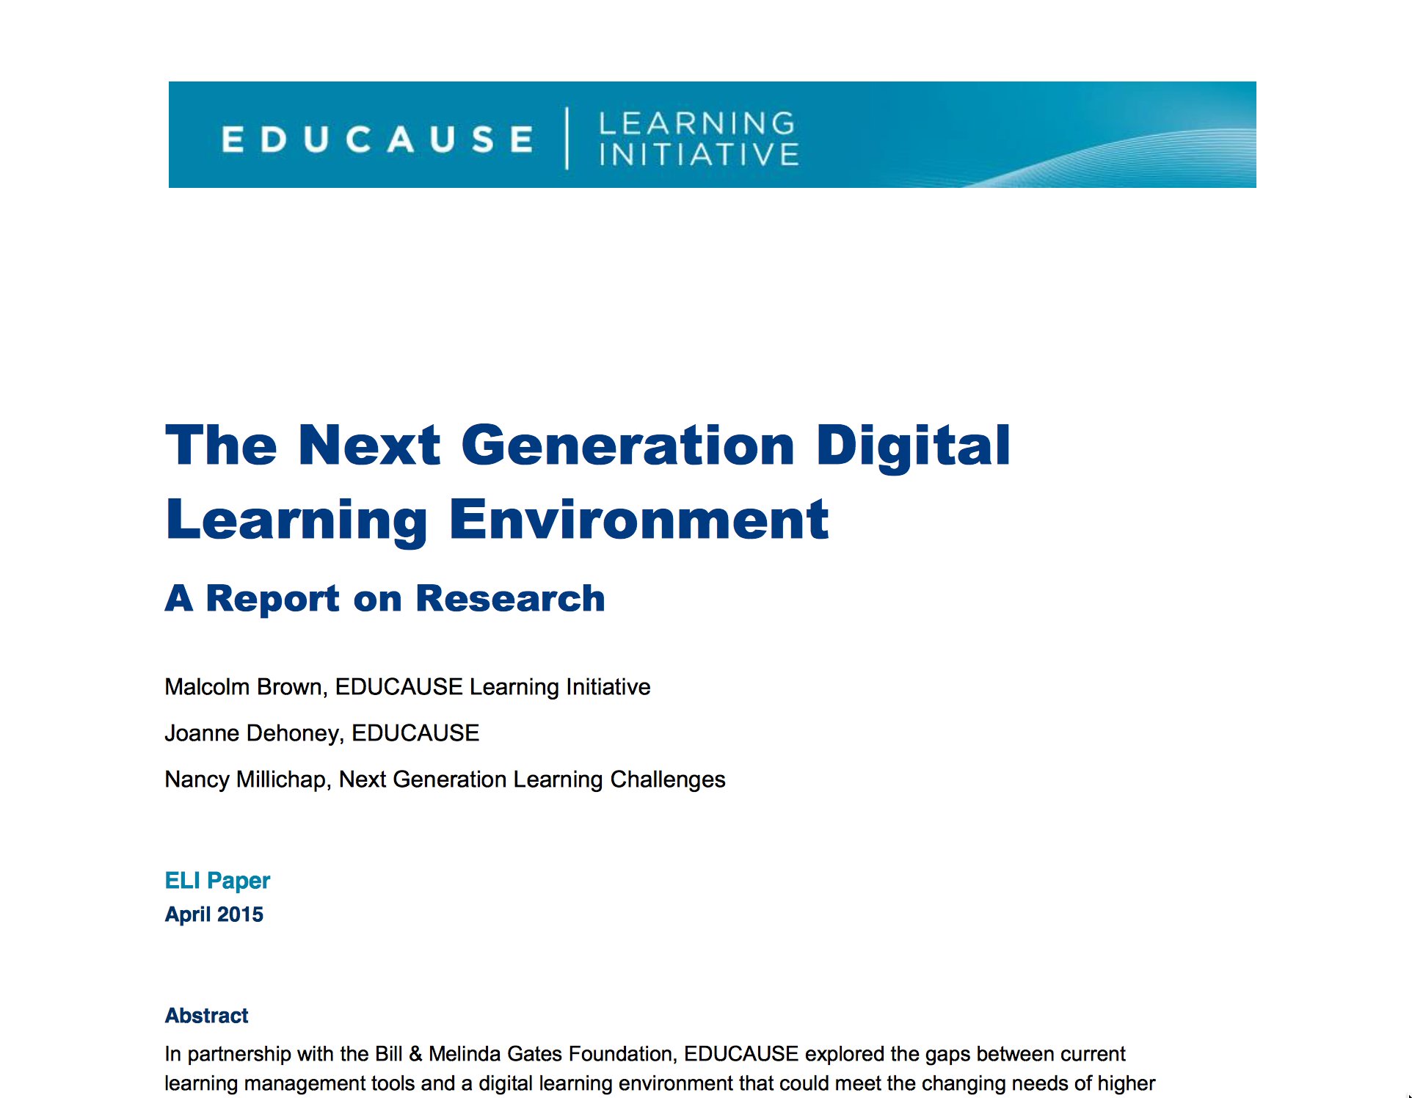
https://net.educause.edu/ir/library/pdf/eli3035.pdf

Slide 4
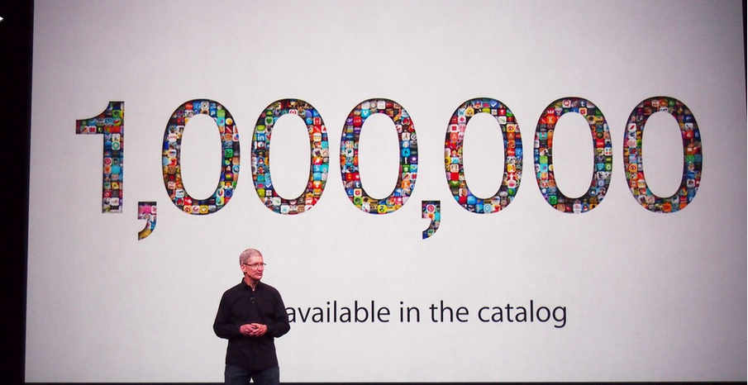
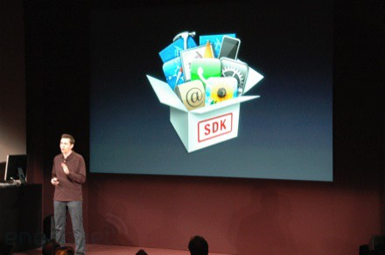
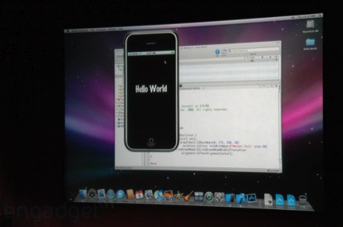
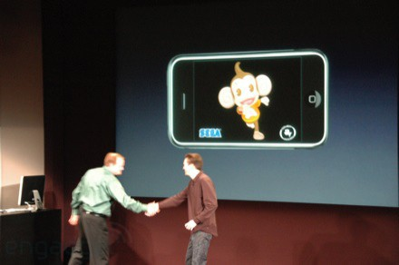
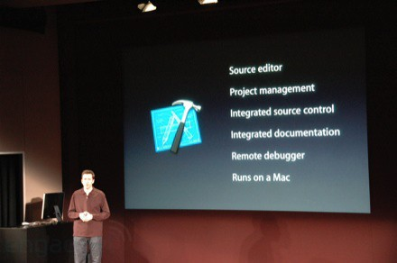
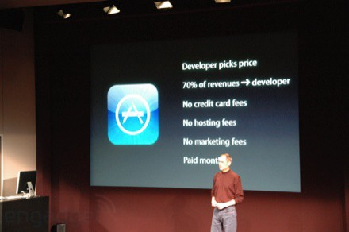
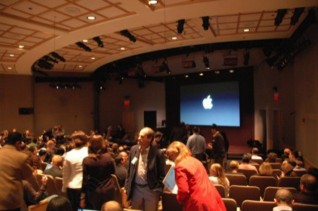
March 6, 2008 iPhone SDK Press Conference

Slide 5


http://planet-fall.deviantart.com/art/The-Monolith-80407794
https://pixabay.com/static/uploads/photo/2014/12/02/22/05/snowflake-554635_960_720.jpg

Slide 6
CONTENT ITEM®
CC®
LTI®
IMS CONTENT ITEM® FILLS THE GAPS AND MAKES CONNECTIONS BETWEEN IMS LEARNING TOOLS INTEROPERABILITY® AND IMS COMMON CARTRIDGE®.
LTI®, CC®, and Content Item® are trademarks of IMS Global Learning Consortium, Inc. (www.imsglobal.org)

Slide 7
CONTENT ITEM®
CC®
LTI®
FOR THE FIRST TIME IN THE HISTORY OF EDUCATIONAL TECHNOLOGY, YOU CAN MAKE AN APP STORE AND LEARNING OBJECT REPOSITORY WITHOUT PROPRIETATY EXTENSIONS.
LTI®, CC®, and Content Item® are trademarks of IMS Global Learning Consortium, Inc. (www.imsglobal.org)

Slide 8
Blackboard
Complete: LTI 1.1, LTI 2.0
In Progress: Content Item and Membership
D2L
Complete: LTI 1.1, Content Item
In Progress: Membership and Gradebook
Canvas
Complete: LTI 1.1, Content Item
Stalled: LTI 2.0, LTI 2.1
Prototyping: LTI 1.3
Moodle
Complete: LTI 1.1, LTI 2.0, Content Item
??

Slide 9
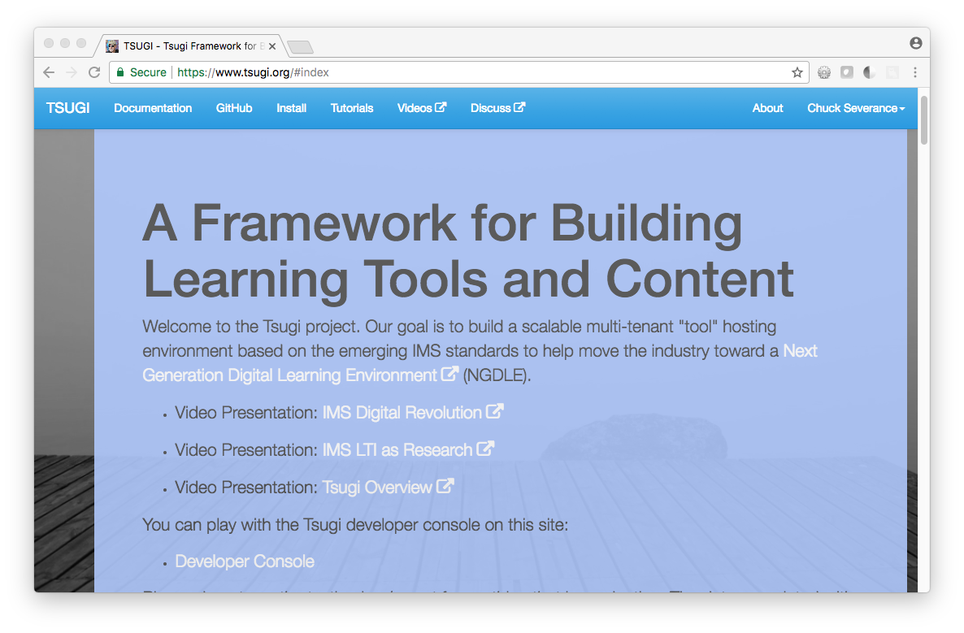

Slide 10
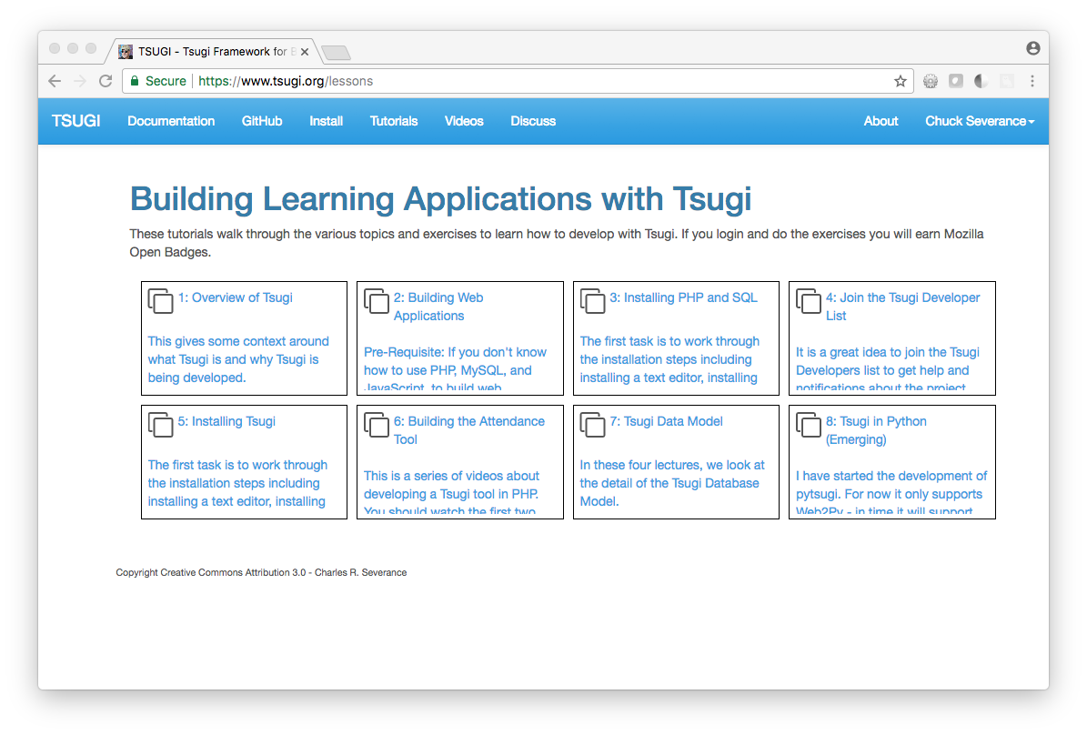

Slide 11
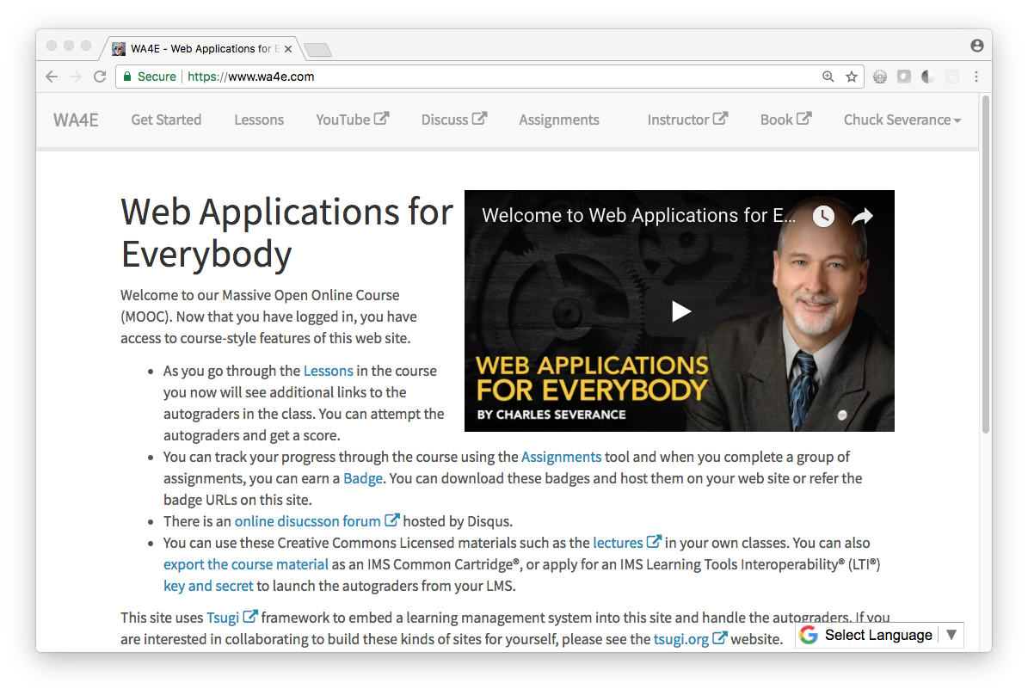

Slide 12
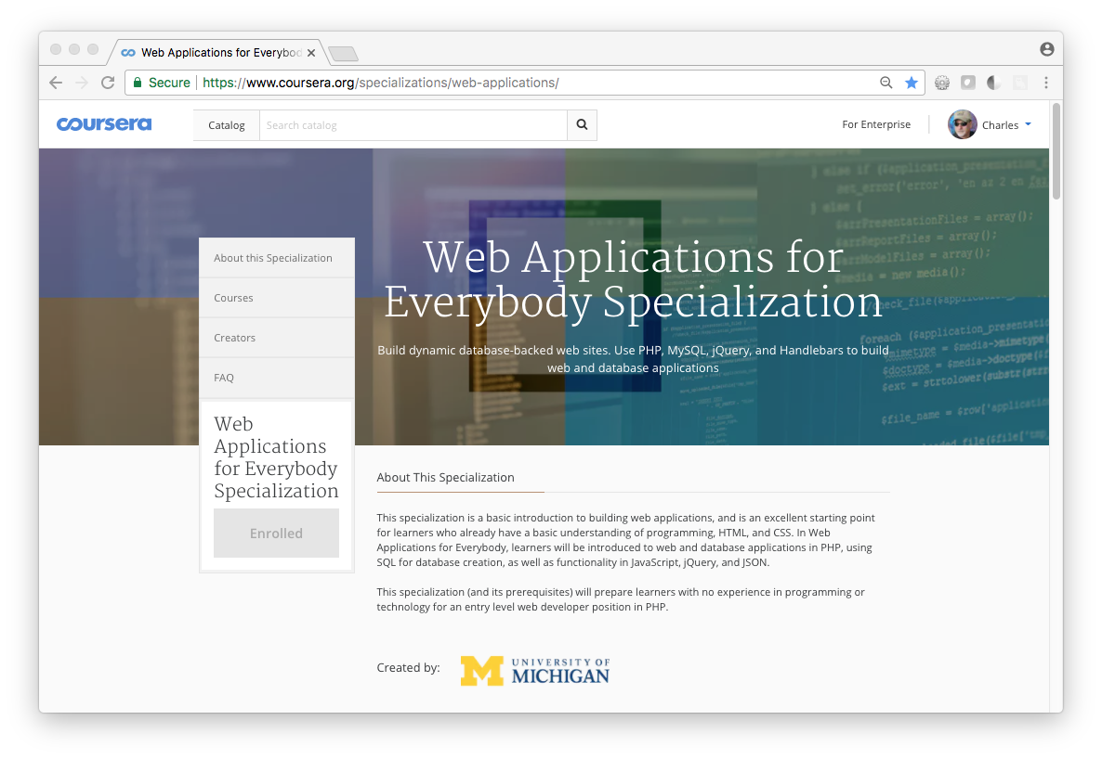

Slide 13
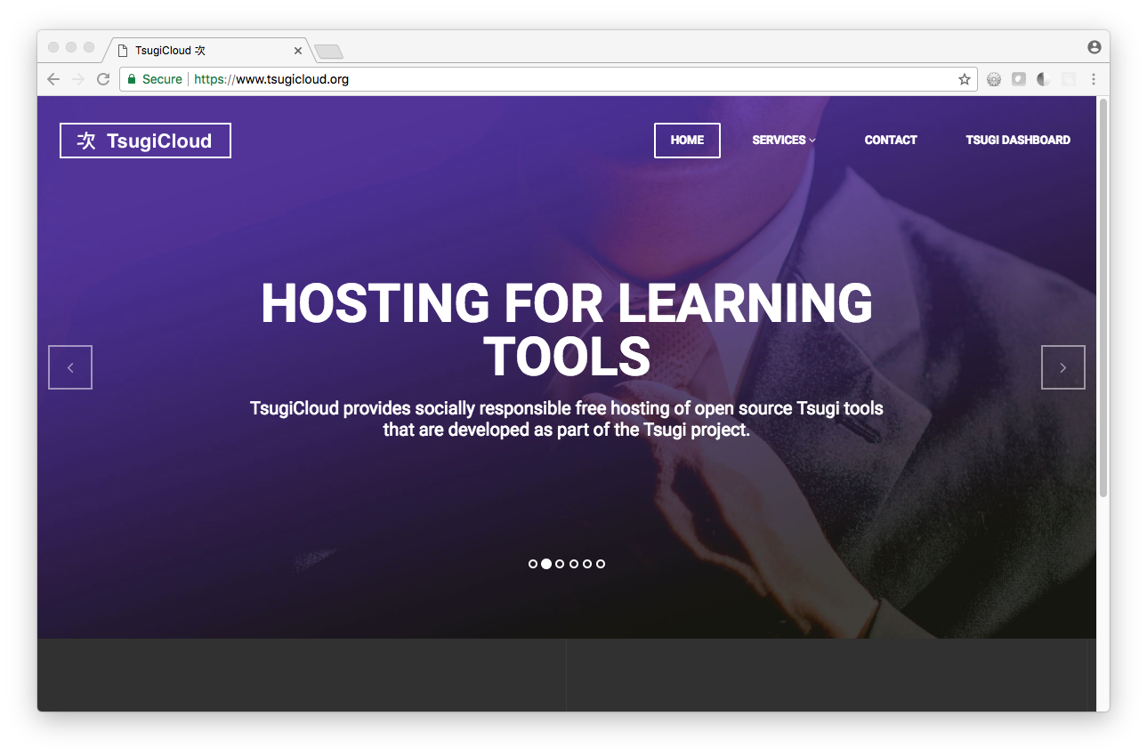
Beta

Slide 14
TsugiCloud.org
Beta
Free scalable hosting for Apereo licensed open source tools
https://github.com/tsugitools
Hosted in Amazon using scalable services/approaches – open source
https://github.com/tsugicloud

Slide 15
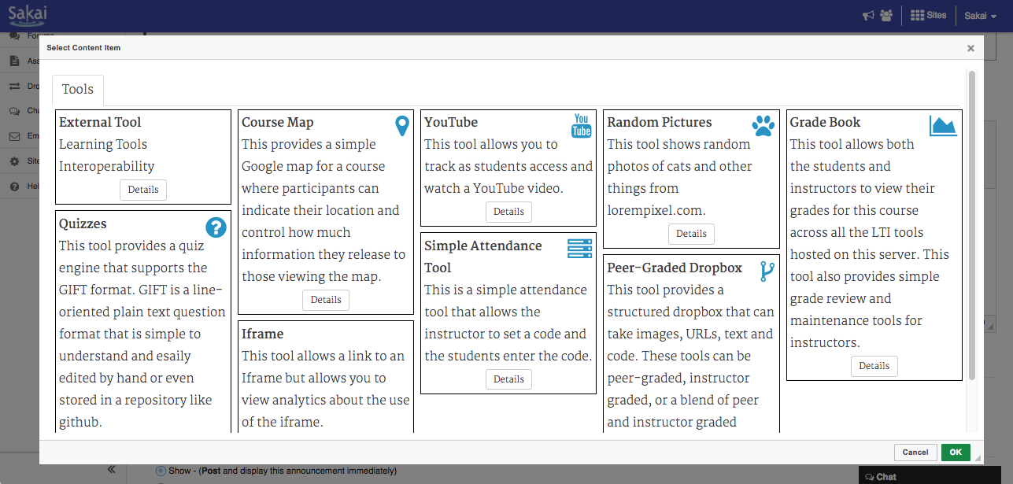

Slide 16
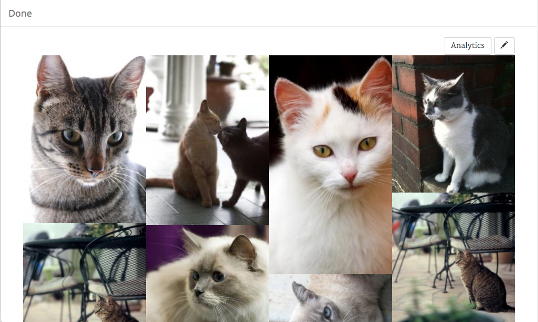

Slide 17
Recent Feature: Tsugi Analytics
Caliper Events – FIFO Queue
Within-Tsugi Analytics – Lossy – but O(1) in space and time

Slide 18
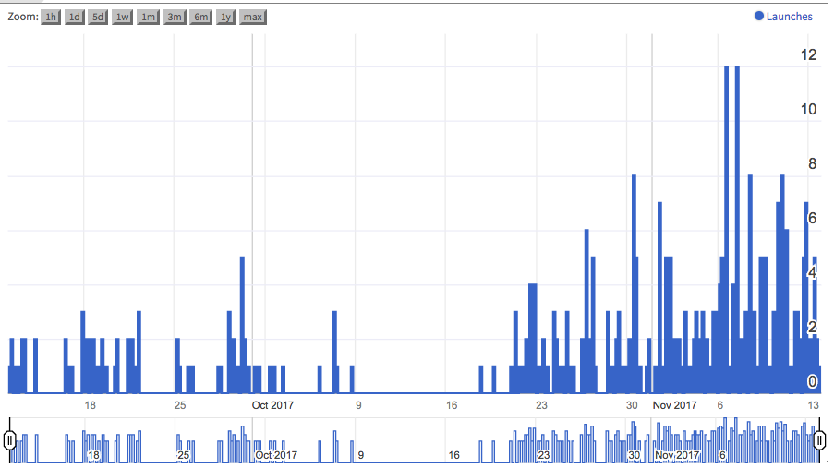

Slide 19
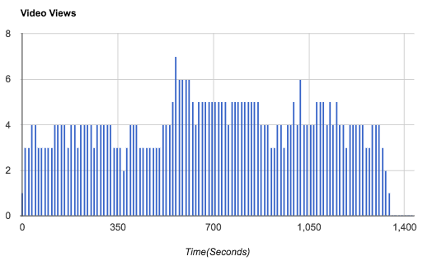

Slide 20
TsugiCloud.org – Amazon Architecture
Beta
cloud-01
DynamoDB
Cloudflare
CDN
Amazon
Load Balancer
cloud-02
Aurora
…

Slide 21
Demo (time permitting)

Slide 22
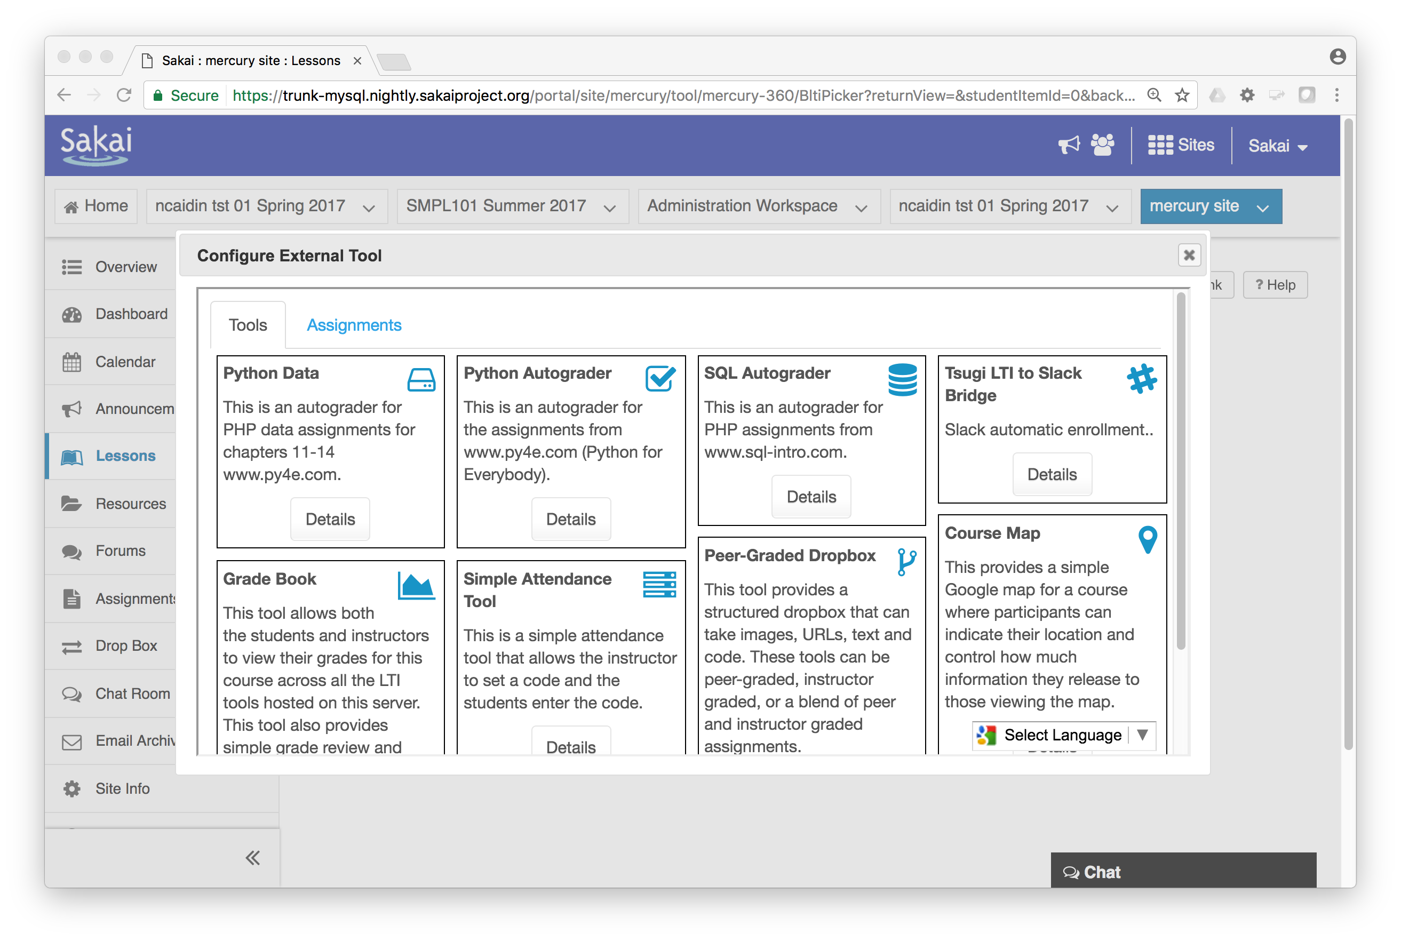

Slide 23
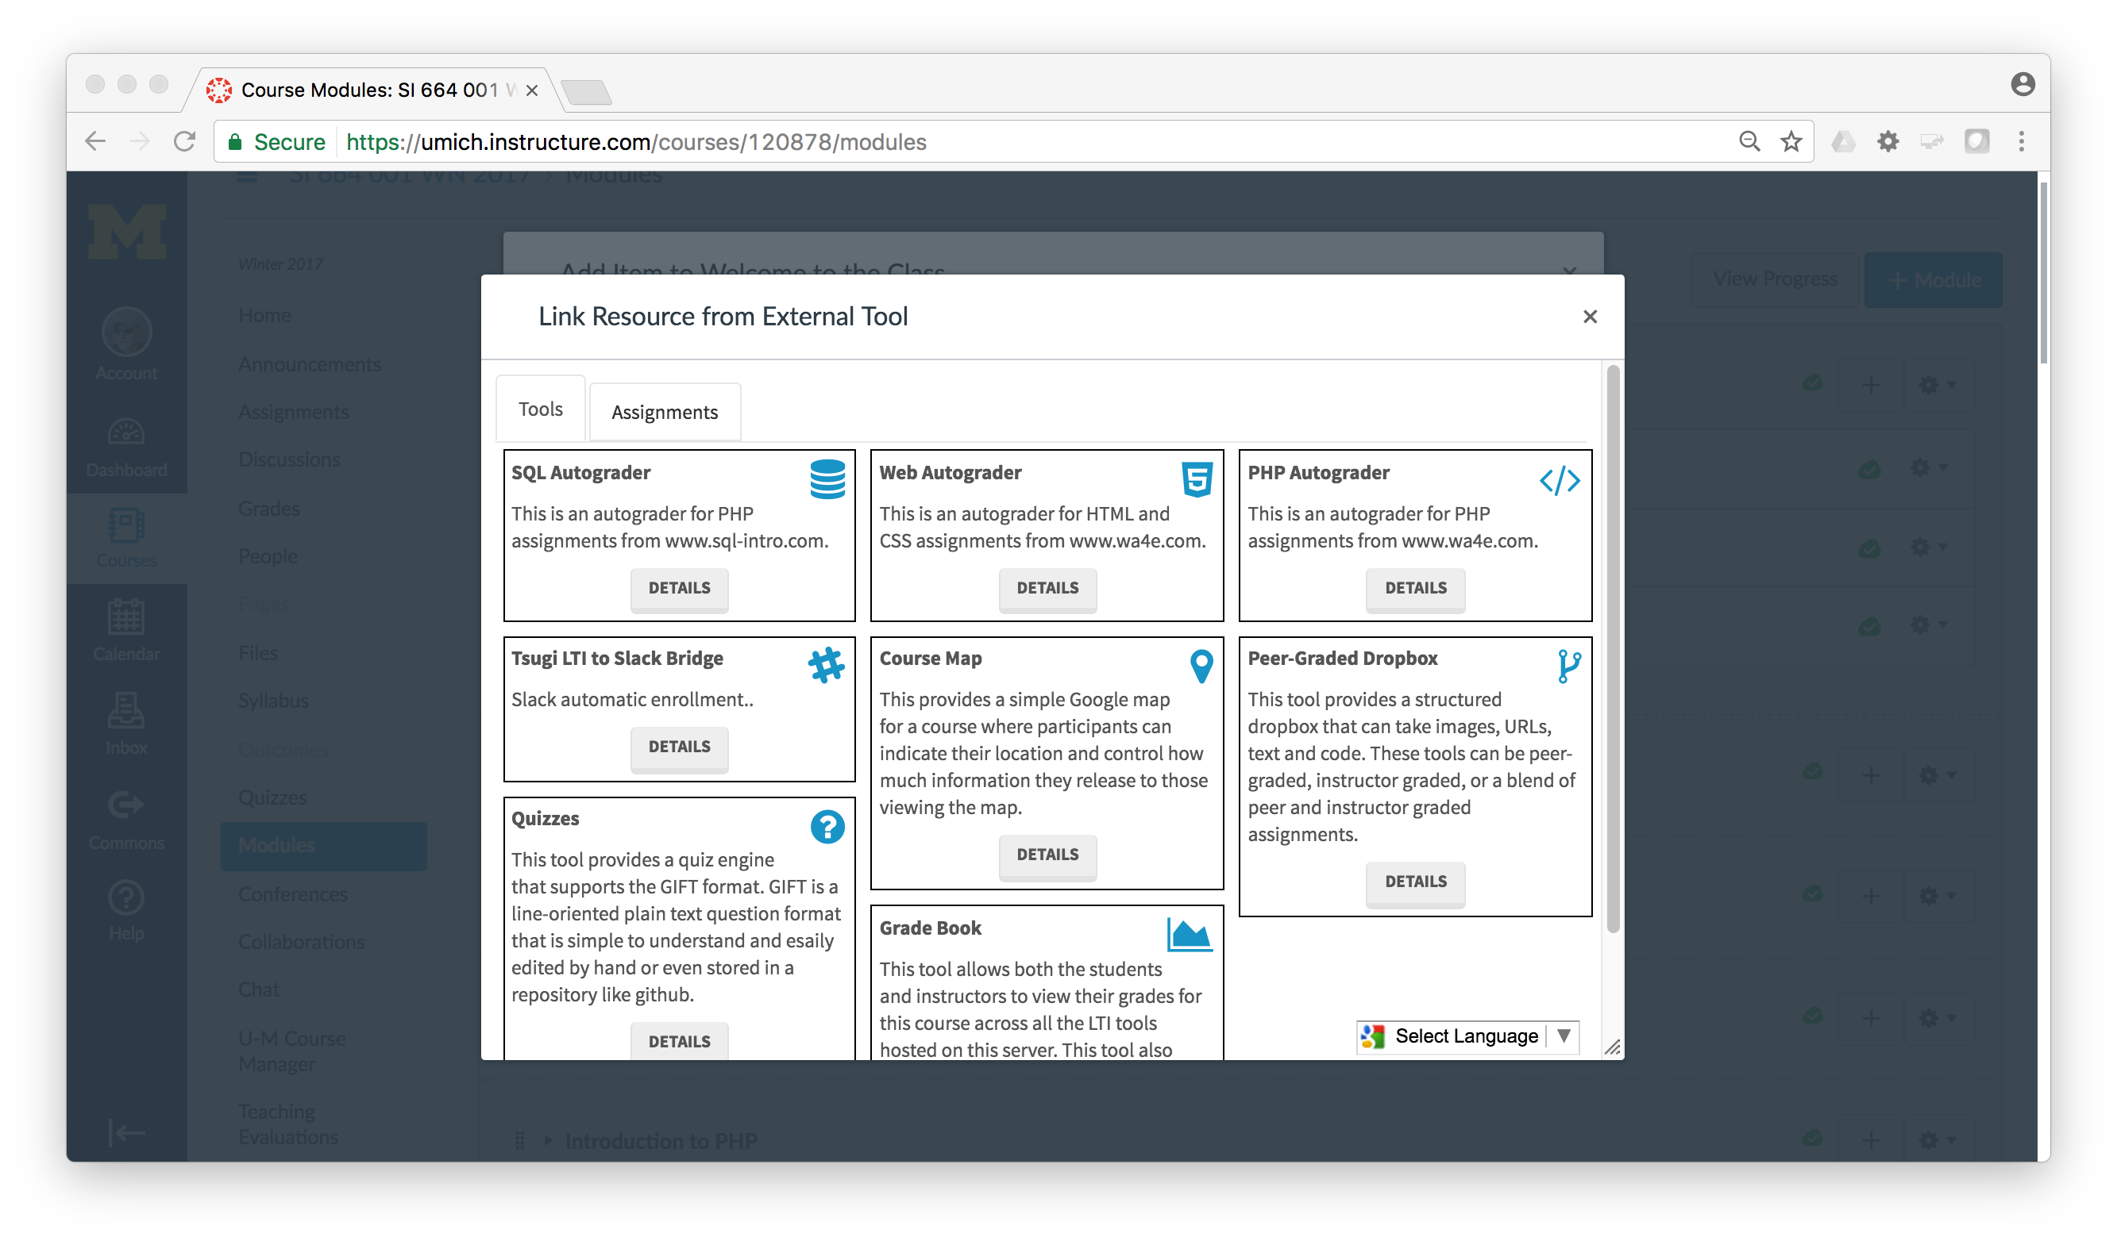

Slide 24
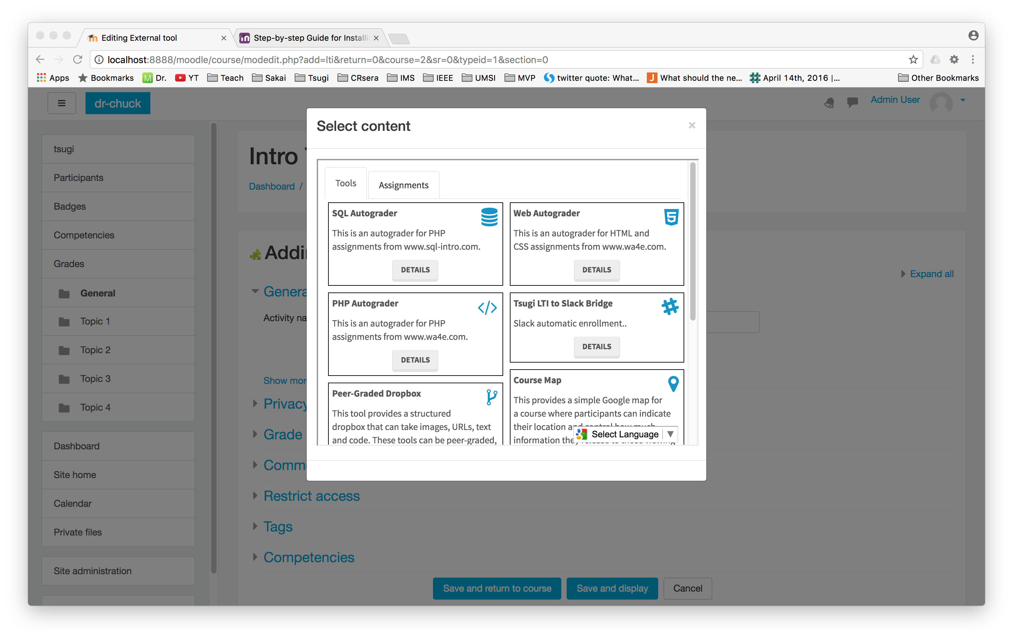

Slide 25
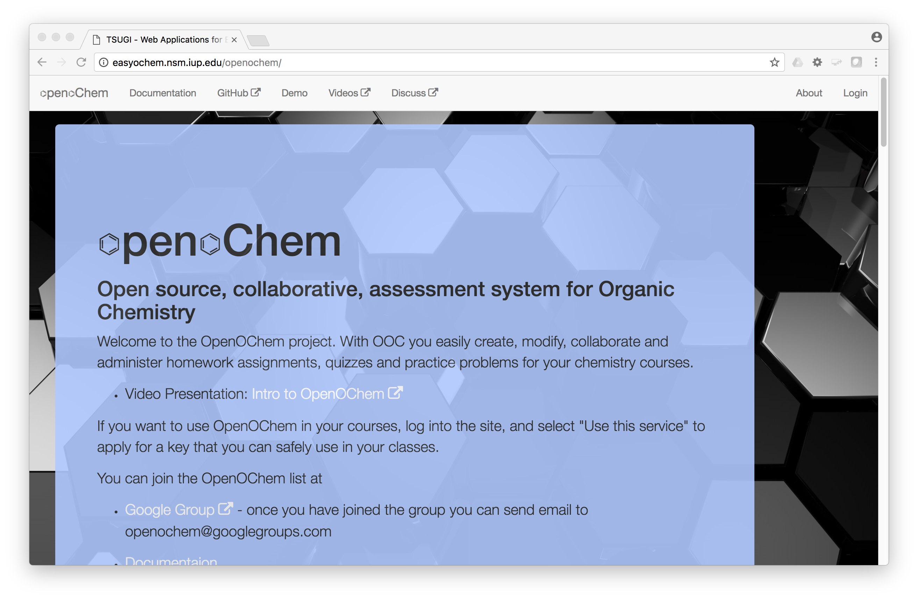
Carl LeBlond, Indiana University of Pennsylvania

Slide 26
Topics
Educational App Store
API Libraries
"Lego Blocks"
Interoperability
New tools that *teach*
EdTech startups made easy
Training / Documentation
Enrich Open Educational Content
Seamless Content Integration and Reuse (LOR)
Stand-Alone MOOC platform
LMS based on Tsugi technology
koseu.org (코스)

Slide 27
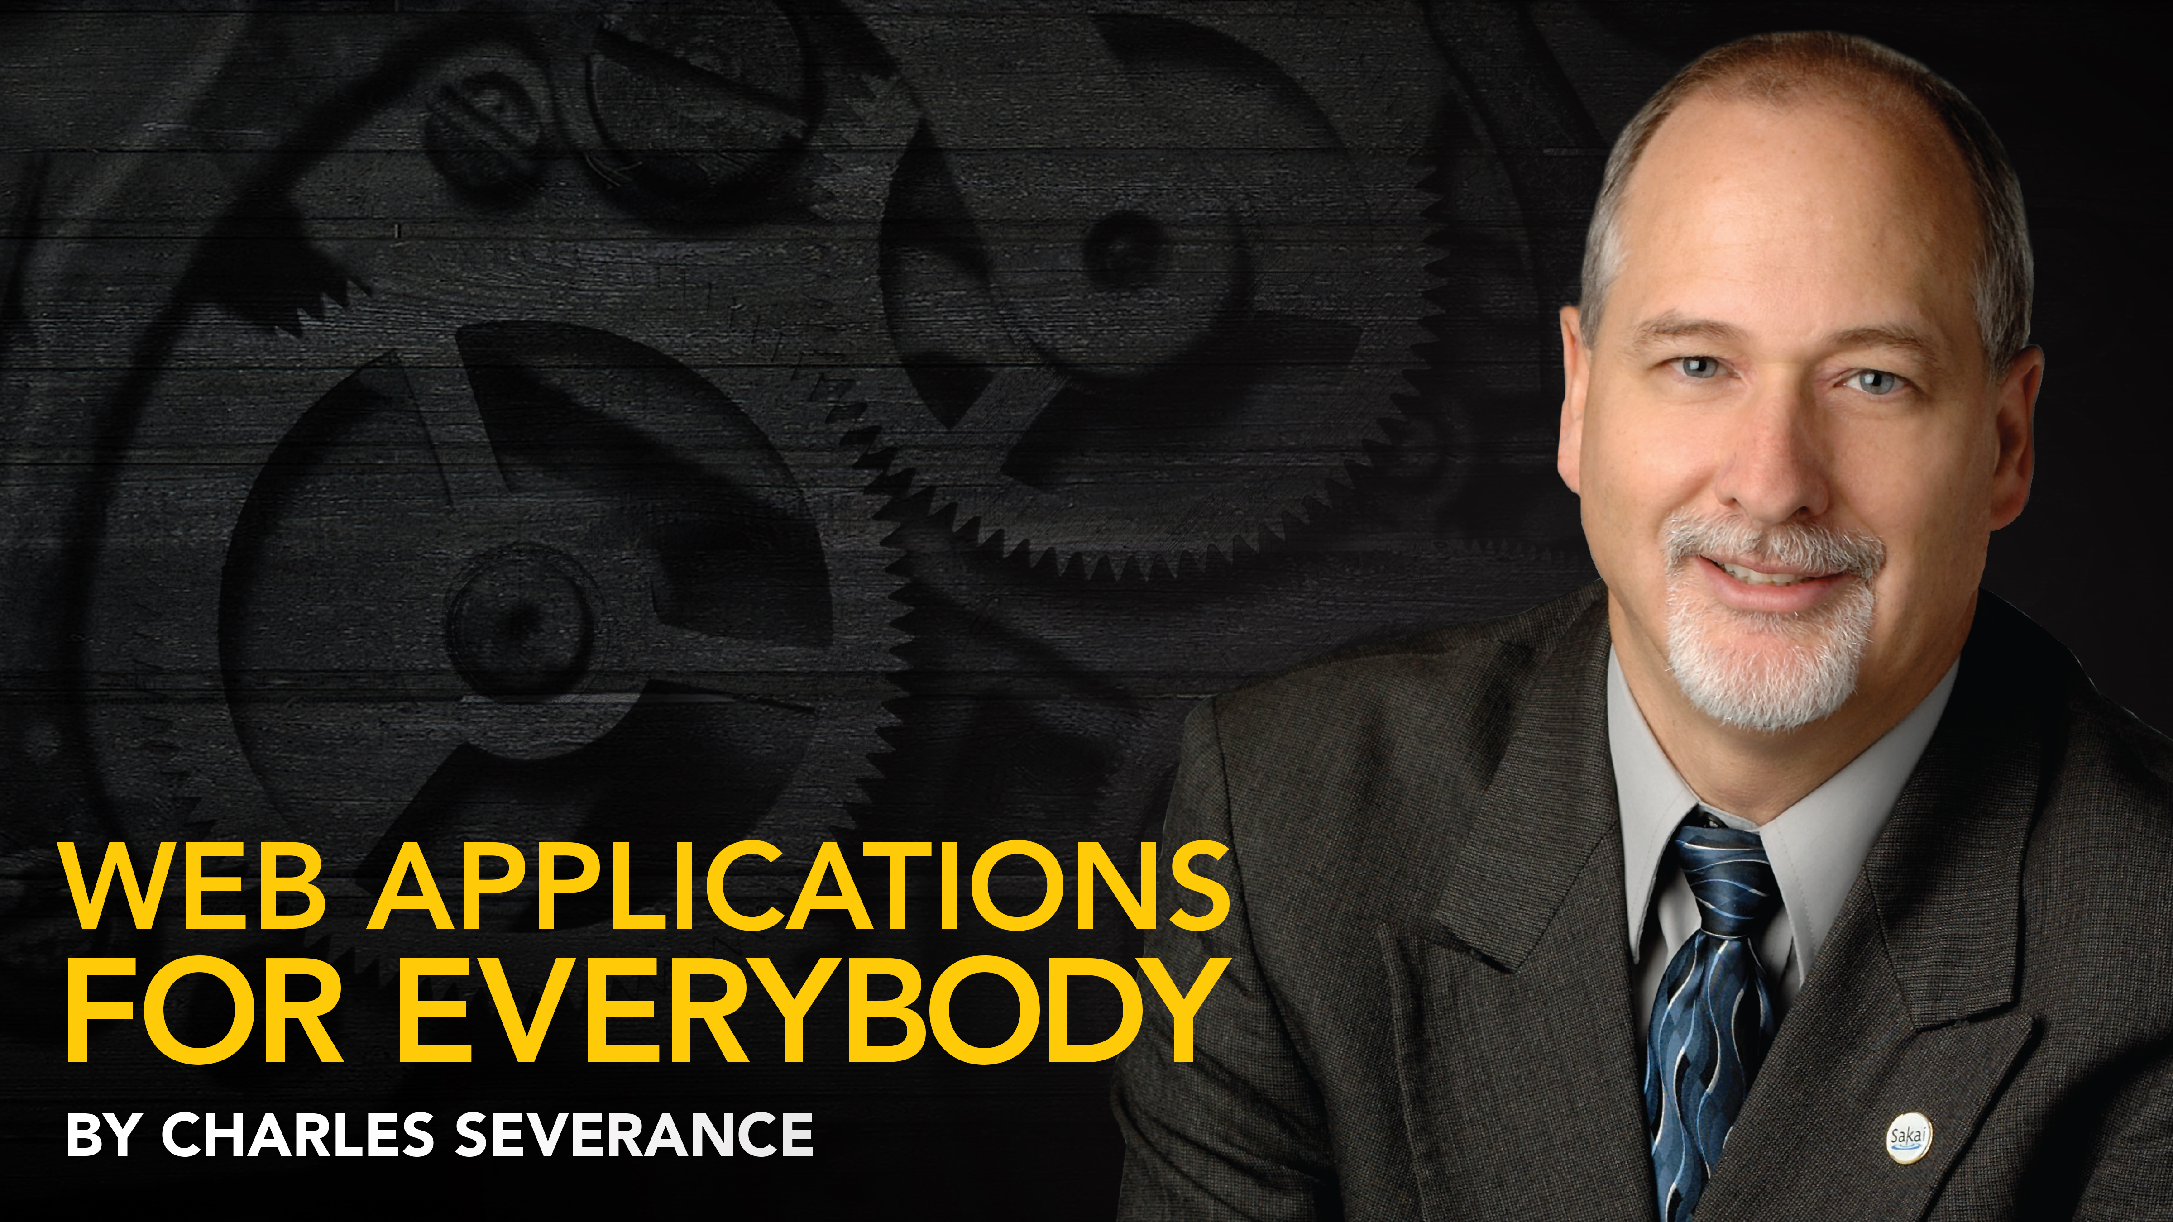
Any Questions? www.tsugi.org www.tsugicloud.org

